Slide 1






TECHUNITY
Developed by
Osama & Lamar.
Supervisor
Dr. John English

Slide 2
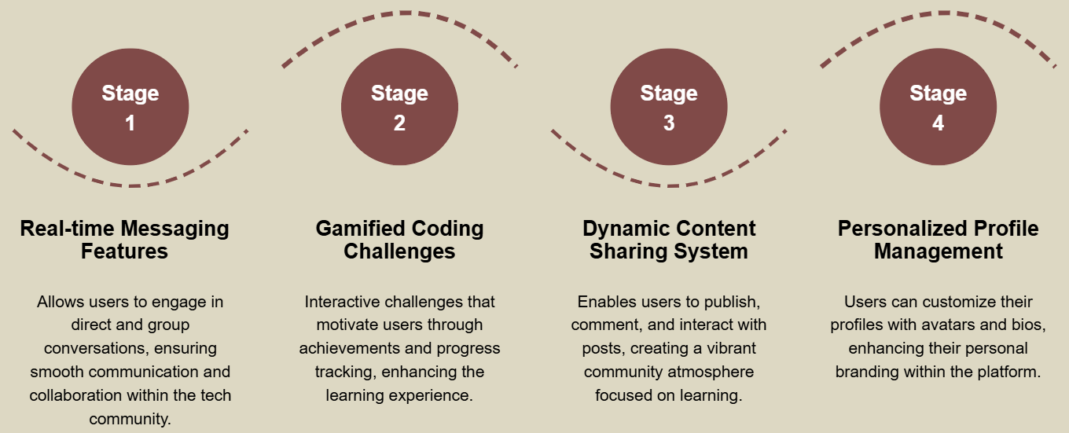
Fostering Connections Among Tech Enthusiasts

Slide 3
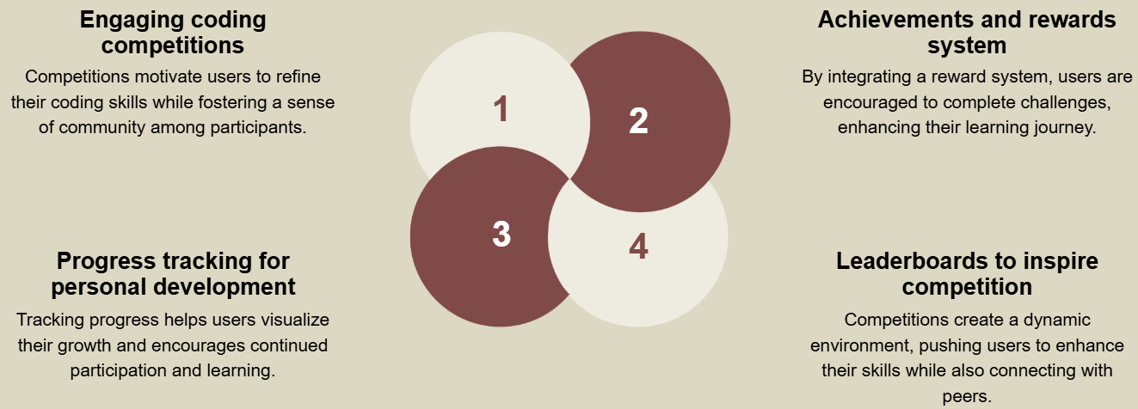
Gamification In Learning

Slide 4
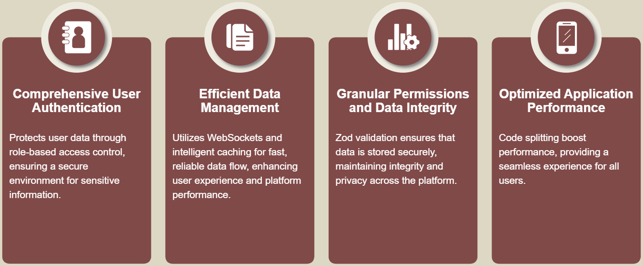
Robust Security & Performance

Slide 5
THANK YOU.
Time To Explore
The Website !

